Slide 1
OAPS (Older Adult Protective Services) Performance Analysis - Visual Comparisons
Notes:
Busy title?

Slide 2

Background
Employed at DHS (different office) – interested in human services
Pursuing certificate in Data Analytics
Data Project – generate compelling inquiry questions and analyze/visualize the data
Notes:
Hmmm, what would you recommend?

Slide 3
Introduction
Data import and clean-up
Questions for analysis
Import from Data Warehouse
Removed duplicates
Removed supervisor entries
How long do investigations take depending on the agency or allegation type?
What are the reasons why cases aren’t closed within 20 days?
Notes:
Talk about years for data set
Assumption about length of investigations as a measure of performance
Bulk of data clean-up involved removing duplicates and supervisor entries
Started with raw data set of 10913 values.
Trimmed down to 9214 for allegations.
7379 for agency comparison.

Slide 4
Measures of Center
Median:
middle value when a data set is ordered from least to greatest
Mean/Average:
adding all numbers in a data set and then dividing by the number of values in the set
Notes:
Statistics as a discipline is powerful because it tells us the overall trends in data, as opposed to us relying on “anec-data.”
So we want to consider what are called the measures of center. Measures of center generally tell us about the middle, or center, of a distribution. The measures of center we’ll focus on are the mean and median.
The mean (average) of a data set is found by adding all numbers in the data set and then dividing by the number of values in the set. The median is the middle value when a data set is ordered from least to greatest. Created by Sal Khan.
https://www.educba.com/mean-vs-median/
“Mean represents the central gravity of the data set. Median represents the mid-point of the data set.

Slide 5

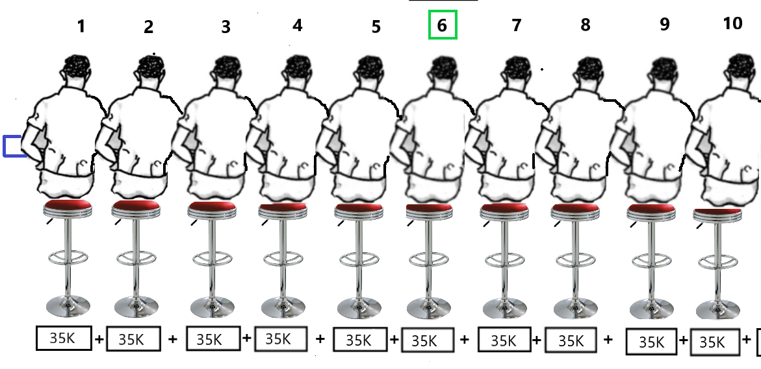
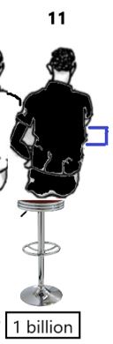
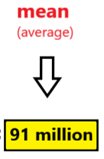
Bill Gates walks into a bar...
Notes:
Explain the scenario outlined by Charles Wheelan’s book “Naked Statistics: Stripping the Dread from the Data”.
10 guys in a Seattle bar, same income of $35,000 – what’s the median income? What’s the average income before Bill Gates walks in?
Bill Gates walks in with an income of 1 billion (for the sake of argument) – what’s the mean/average income?
Can I figure out some timed entry for certain parts of the picture?
What’s the point of this exercise? Demonstrating that mean is sensitive to outliers. Median is not sensitive to outliers.
Both mean and median are useful in their own right. Comparing the two in charts will give us a sense of the center, but also the spread of the data.

Slide 6
How long does it take for each agency to complete investigations?

Slide 7
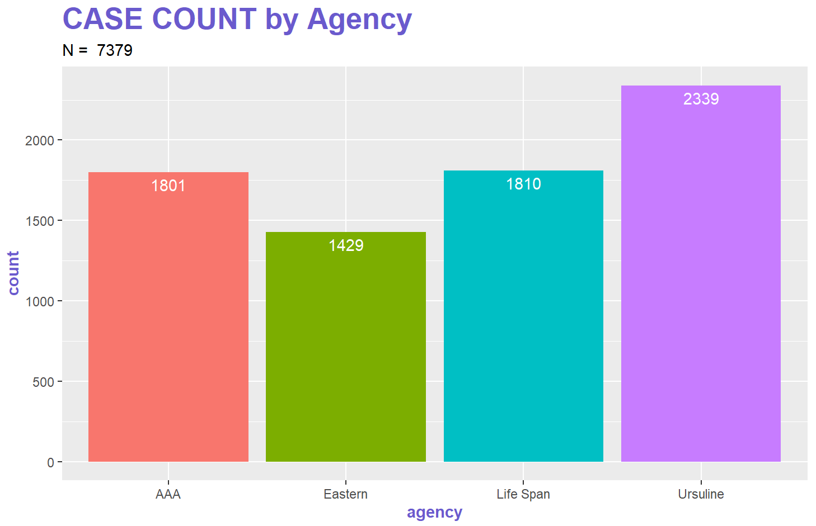
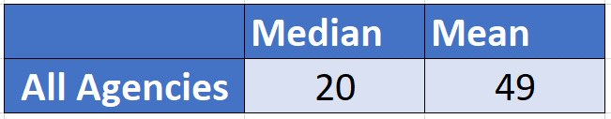
Notes:
N=7379 reflects removal of records without either a start date or end date, thus not allowing the ability to calculate the difference in days for these records.

Slide 8
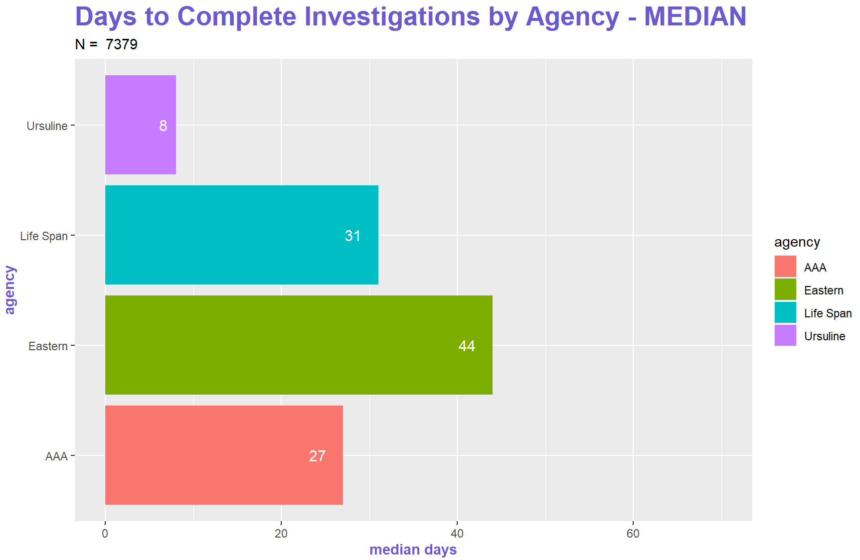

Slide 9
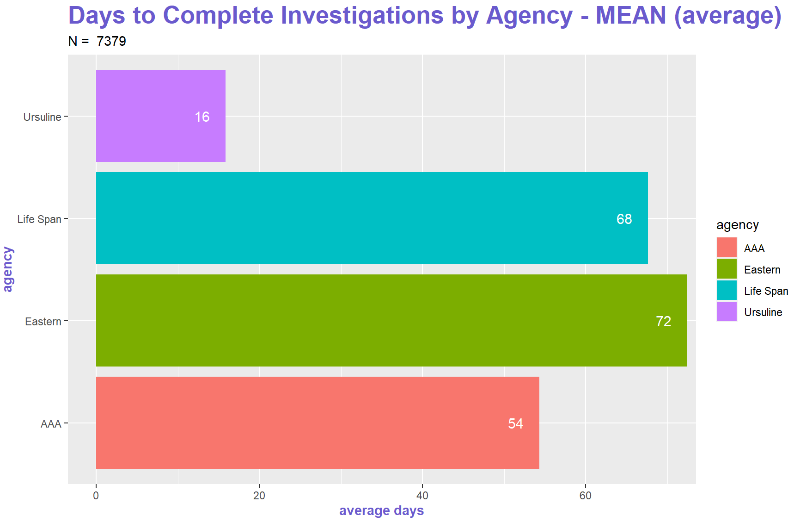

Slide 10
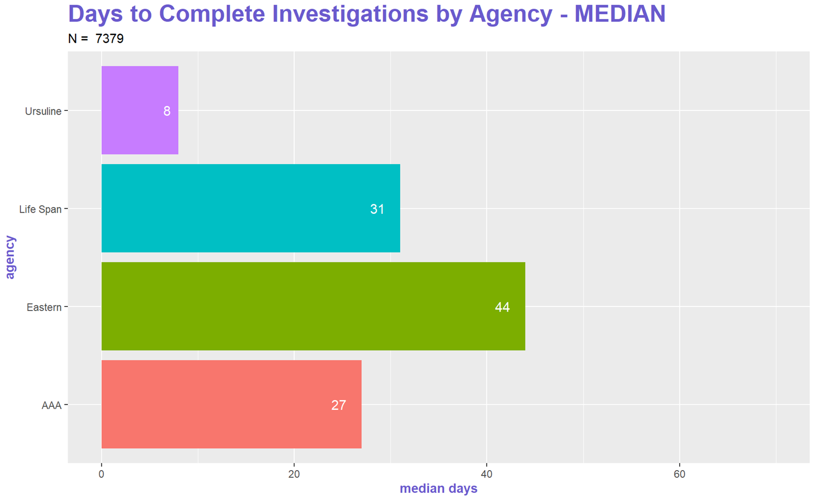
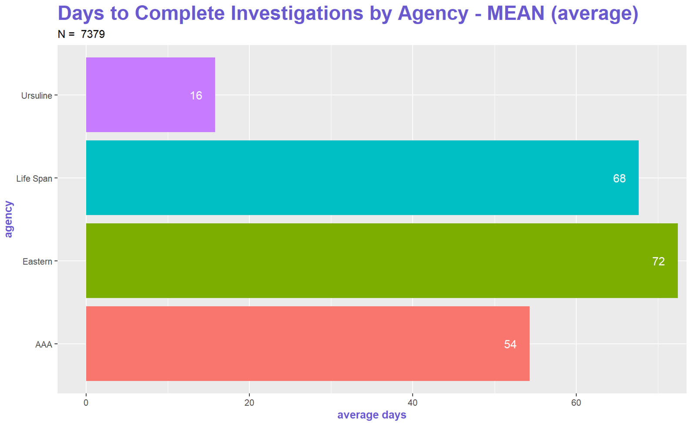

Slide 11
How long does it take to complete investigations based on allegation type?

Slide 12
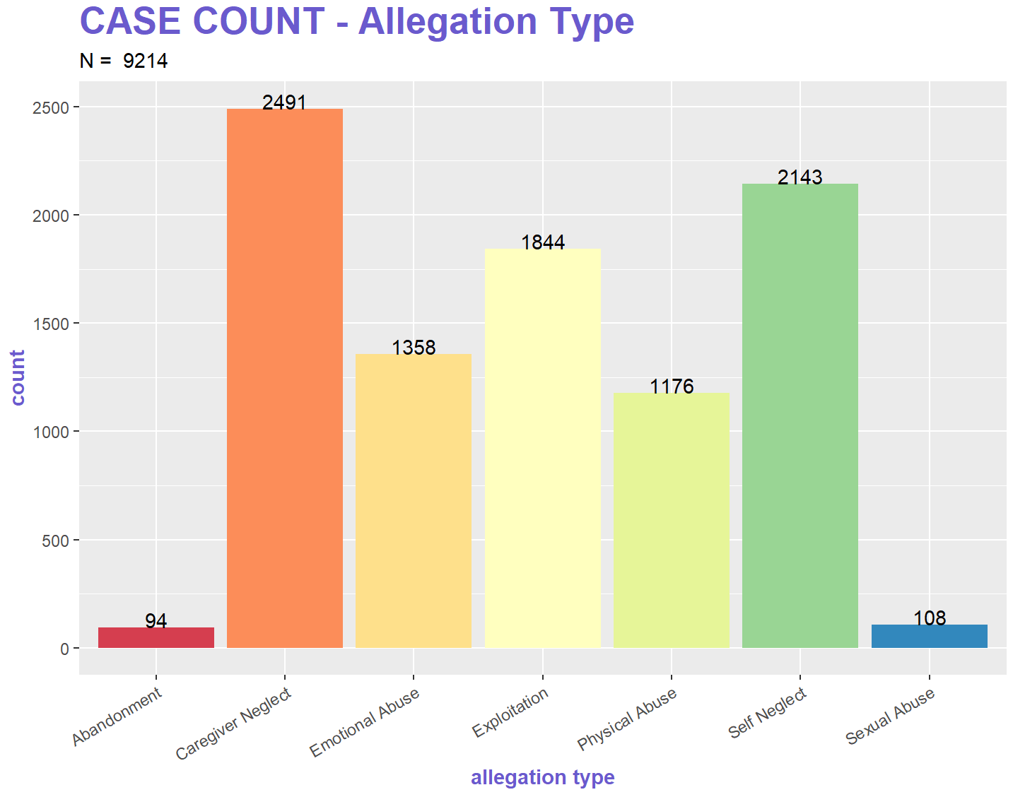
Notes:
N = 10209 reflects breaking out of multiple values in one column into separate columns and making separate records to account for each allegation

Slide 13
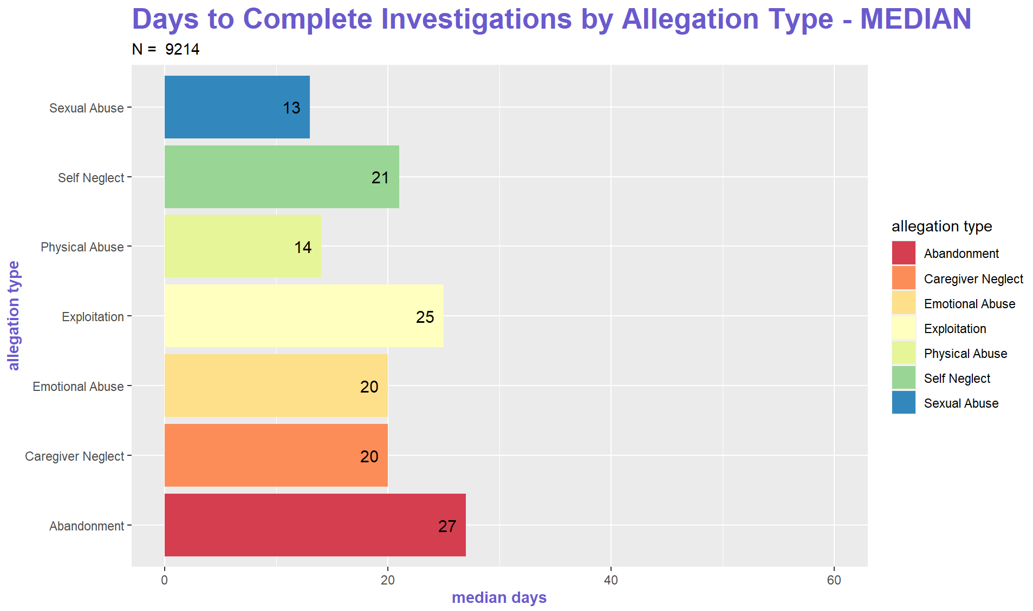

Slide 14
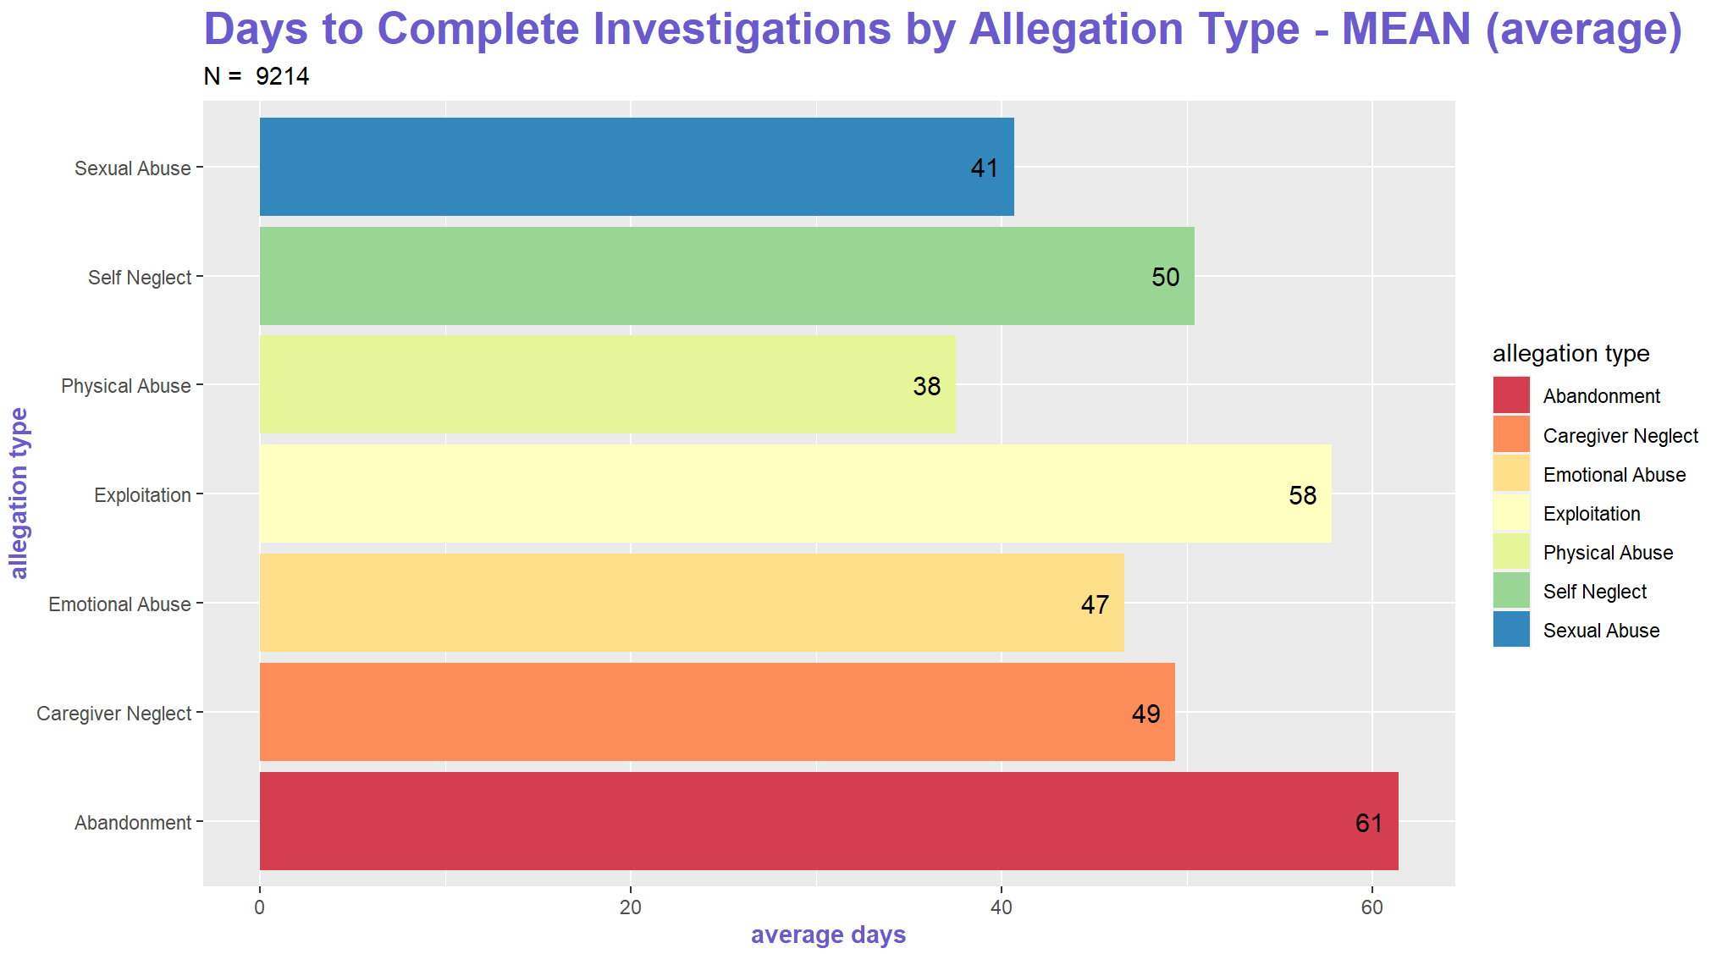

Slide 15
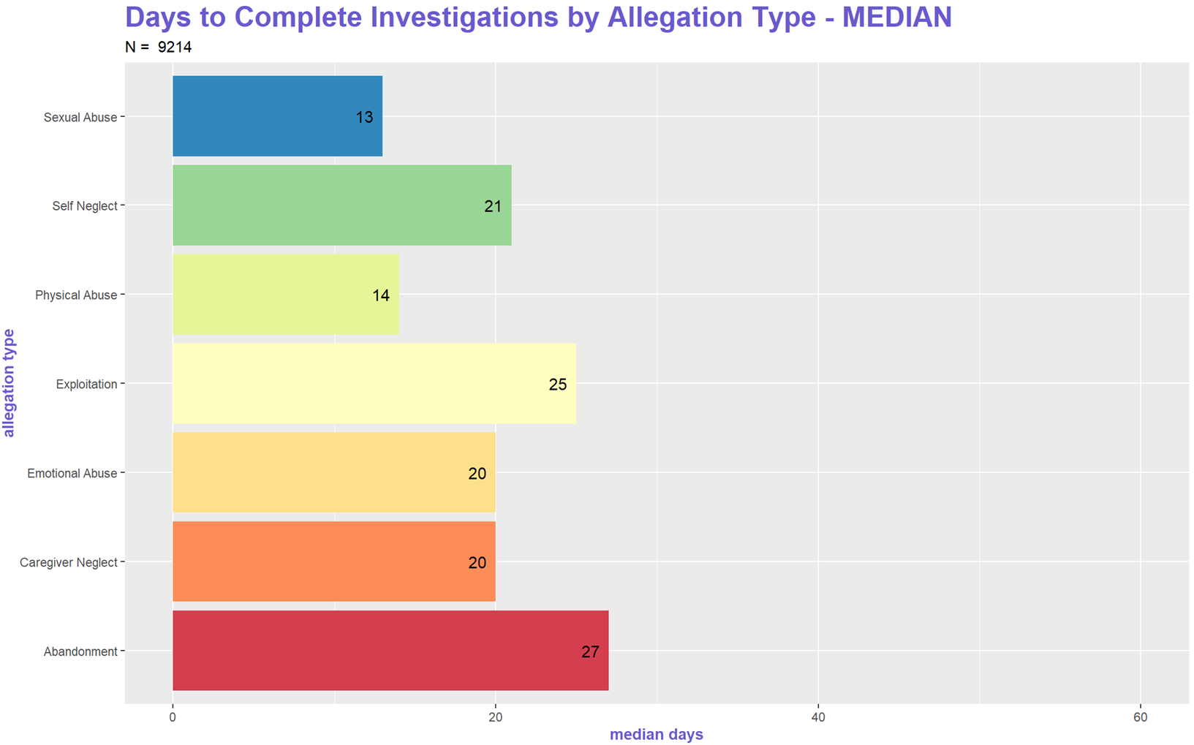
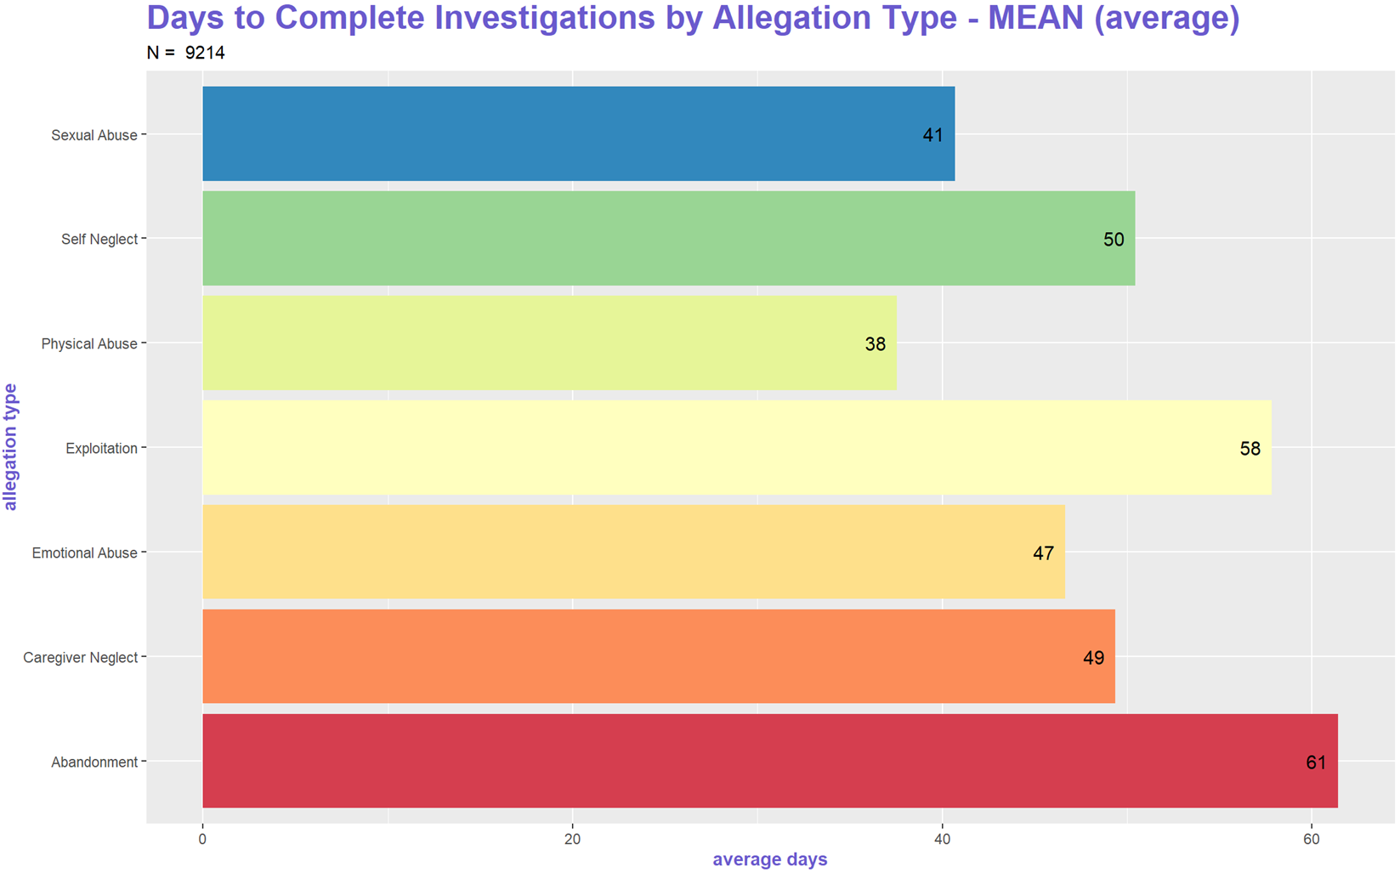

Slide 16
How long do investigations take depending on the agency and allegation type?

Slide 17
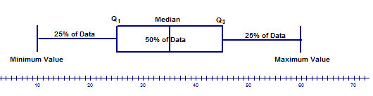
Putting it all together: box plots
What a box plot shows:
Notes:
Explain what a box and whisker plot is and why it’s useful as a data visualization for this particular analysis.
“A box and whisker plot is defined as a graphical method of displaying variation in a set of data. In most cases, a histogram analysis provides a sufficient display, but a box and whisker plot can provide additional detail while allowing multiple sets of data to be displayed in the same graph.
(https://asq.org/quality-resources/box-whisker-plot)
Box and whisker plots portray the distribution of your data, outliers, and the median. The box within the chart displays where around 50 percent of the data points fall. It summarizes a data set in five marks. The mark with the greatest value is called the maximum. It will likely fall far outside the box. The mark with the lowest value is called the minimum. It will likely fall outside the box on the opposite side as the maximum.
The box itself contains the lower quartile, the upper quartile, and the median in the center. The median is the value separating the higher half from the lower half of a data sample, a population, or a probability distribution.
(https://www.tableau.com/data-insights/reference-library/visual-analytics/charts/box-whisker)
Minimum value: The smallest value in the data set
Second quartile: The value below which the lower 25% of the data are contained
Median value: The middle number in a range of numbers
Third quartile: The value above which the upper 25% of the data are contained
Maximum value: The largest value in the data set”

Slide 18
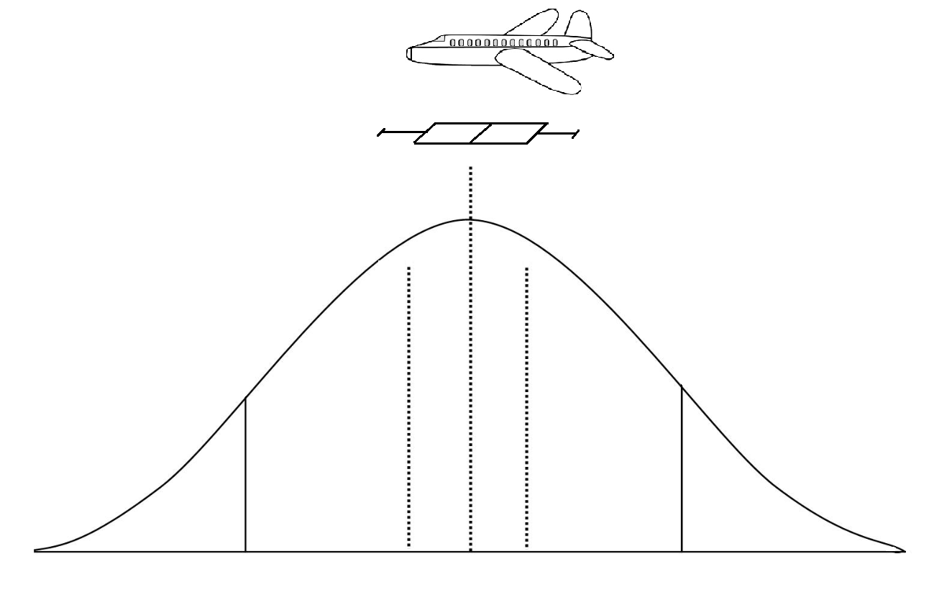
Box plots: an aerial view of the data set
Notes:
This could be a possible way to explain box plots...

Slide 19
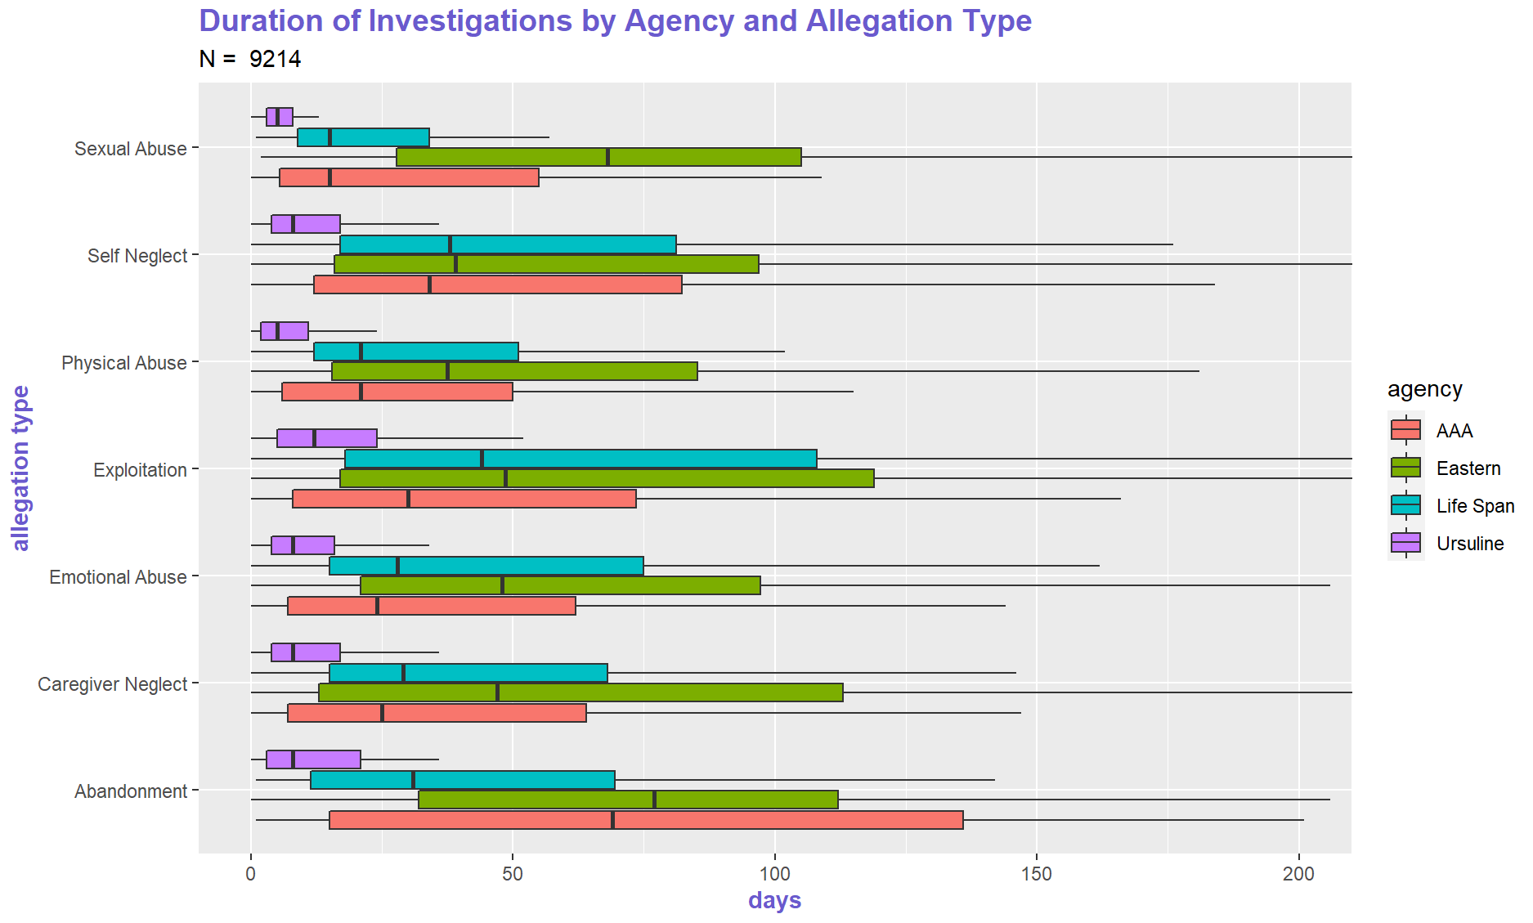
Notes:
How do good people do things differently – introducing a competition – best ones to share with others – be sensitive to this. Caring people in this work.
How long are people waiting to receive information from outside.
Is Ursuline more annoying? People who are expediters. What do agencies do to expedite things?

Slide 20
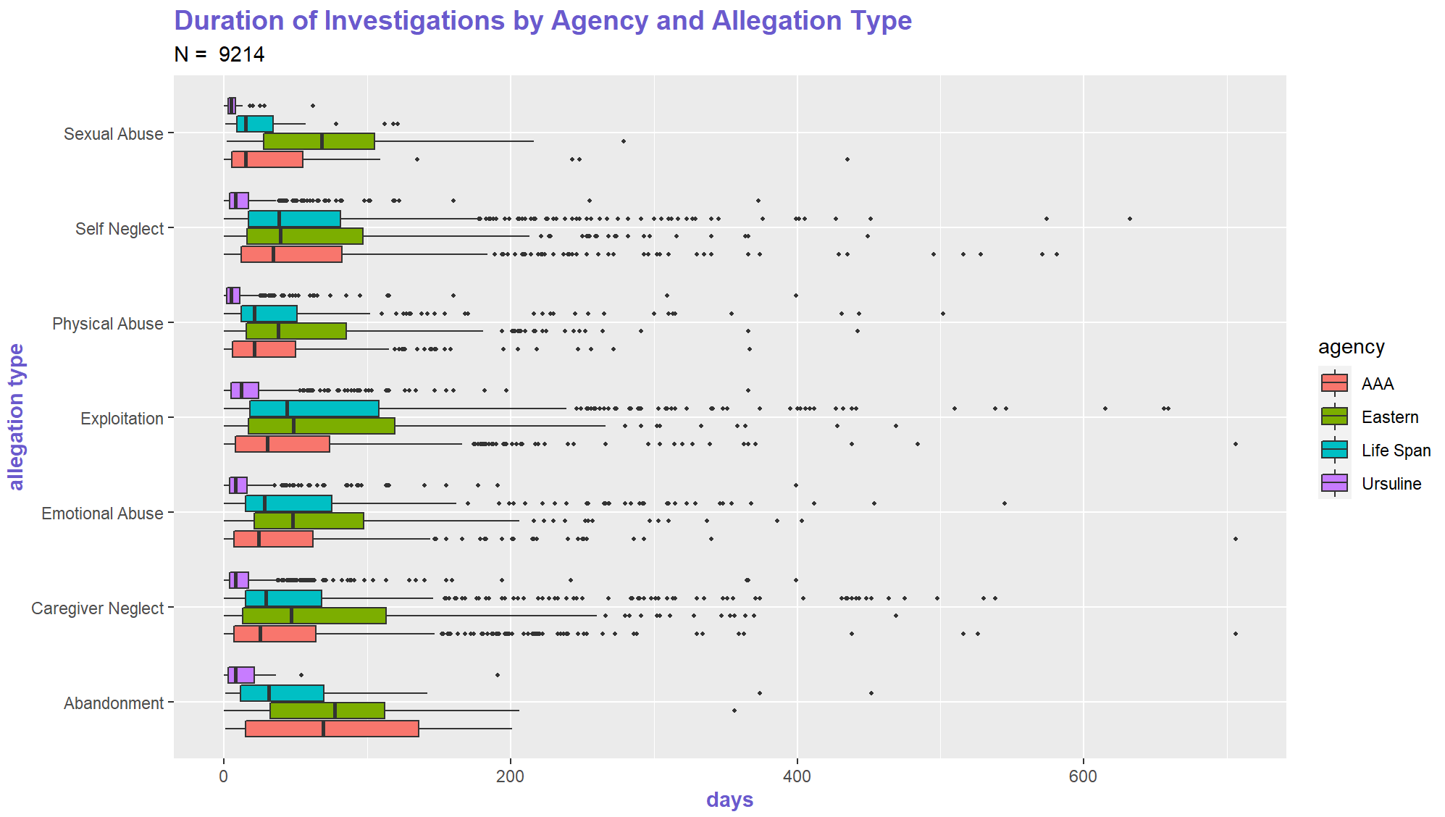
Notes:
Should this one go first?

Slide 21
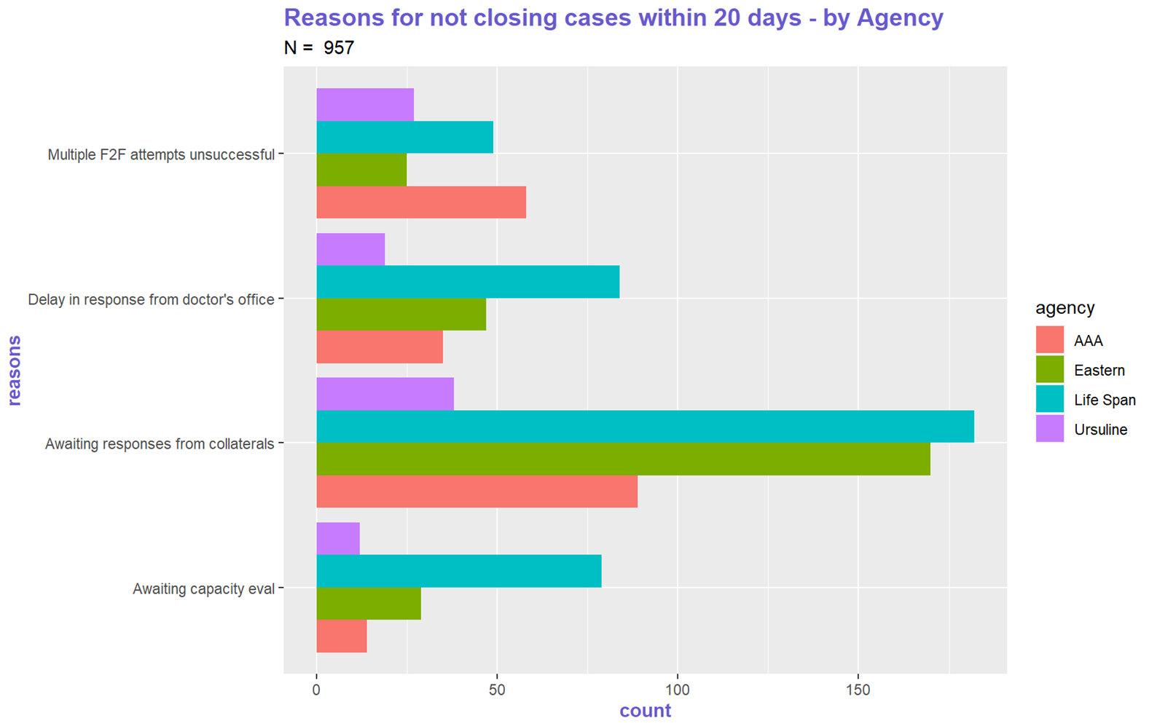
Notes:
Why does Ursuline wait less? “Holy crap, why are we waiting so long?” – Paula Shubock
Maybe we should talk to Ursuline beforehand – optimal outcome is for them to share their secret sauce
Best practices meetings
Collaborative effort?
Take out awaiting financial records – APS only

Slide 22
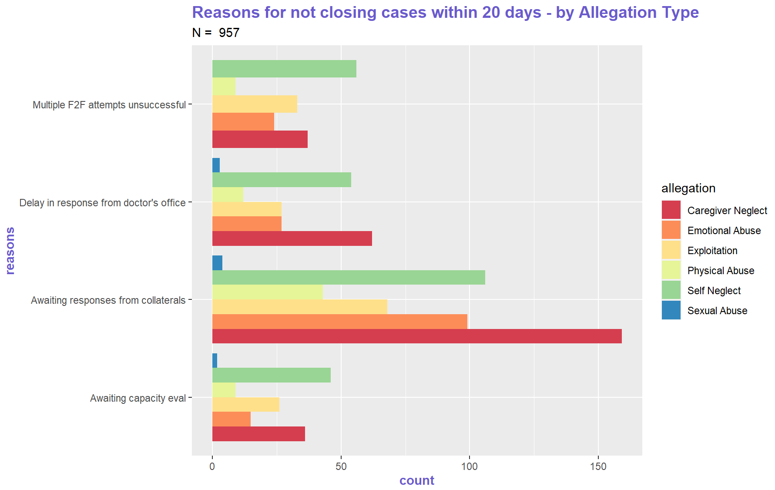
Notes:
Awaiting financial records – APS only – delete this

Slide 23
Conclusion
Conclusion:
Some agencies are waiting longer on information needed to complete investigations – why is that?
Food for thought:
Gather more data on self-reported reasons for not closing cases within 20 days
Conclusion:
Agency performance does not seem to be contingent upon allegation types
Food for thought:
Further investigate who expedites the flow of information into the agency

